Slide 1
+ TreeBuilder
+ filesToString (pathname : String) : String
+ makeSyntaxTree (sourceCode: char[], classpath: String[], sources: String[], unitName:String): ASTNode
+ Assign1
+ main (args : String): void
+UserContact
+ getPathname(): String
+ getTargetType(): String
+ getJarFiles(): String[]
+ isValidDir(pathname:String):boolean
+TypeCounter
+ decCount : int
+ refCount : int
+ countDec (cu: ASTNode): int
+ countRef (cu: ASTNode): int
+ ASTParser
+ K_EXPRESSION: int
+ K_STATEMENTS: int
+ K_CLASS_BODY_DECLARATIONS: int
+ K_COMPILATION_UNIT: int
+ newParser(level: int): ASTParser
+ setSource(source: char[]): void
+ setKind(kind: int): void
+ setResolveBindings(enabled: boolean): void
+ setBindingsRecovery(enabled: boolean): void
+ setUnitName(unitName: String): void
+ setEnvironment(classpathEntries: String[], sourcepathEntries: String[], encodings: String[], includeRunningVMBootclasspath: boolean): void
+ createAST(monitor: IProgreeMonitor): ASTNode
…
+ ASTVisitor
+ visit (node: AnnotationTypeDeclaration) : boolean
+ visit (node: EnumDeclaration) : boolean
+ visit (node: TypeDeclaration) : boolean
+ visit (node: SimpleType) : boolean
+ visit (node: PrimitiveType) : boolean
+ visit (node: MarkerAnnotation) : boolean
+ visit (node: NormalAnnotation) : boolean
…
+ ASTNode
+ COMPILATION_UNIT: int
+ ANNOTATION_TYPE_DECLARATION: int
+ ENUM_DECLARATION: int
+ TYPE_DECLARATION : int
+ SIMPLE_TYPE: int
+ PRIMITIVE_TYPE : int
+ MARKER_ANNOTATION: int
+ NORMAL_ANNOTATION : int
+ accept(visitor: ASTVisitor): void
+ toString(): String
…
+ CompilationUnit
+Type
+ getQualifiedName(): Name
+ resolveBinding(): ITypeBinding
…
+AbstractTypeDeclaration
+ getName(): SimpleName
+ resolveBinding(): ITypeBinding
…
+Annotation
+ getTypeName(): Name
+ resolveBinding(): ITypeBinding
…
+ AnnotationTypeDeclaration
+ SimpleType
+ PrimitiveType
+ NormalAnnotation
+ MarkerAnnotation
+ TypeDeclaration
+ EnumDeclaration

Slide 2
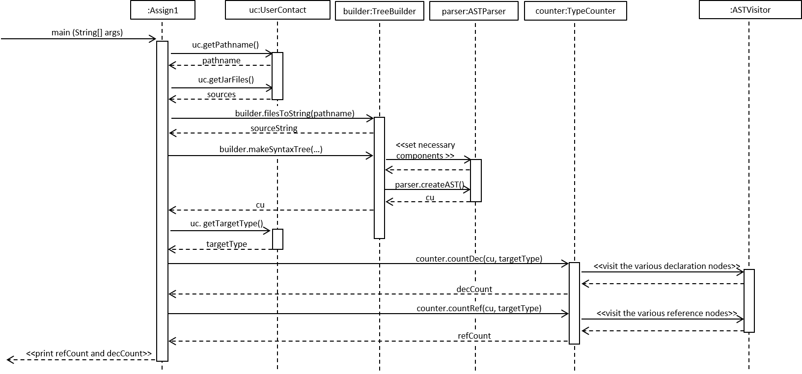

Slide 3
getPathname(…)
getjarFiles(…)
User has code and wants to count declarations & references for a gven type
uc.getPathname(…)
uc.getJarFiles(…)
uc.getTargetType(…)
Pathname and/or jar files source is invalid
Have valid pathname and jar files source
uc.isValidDir(pathname)
uc.isValidDir(sources[0])
builder.filesToString(…)
builder.makeSyntaxTree(…)
Have a tree to traverse and count declarations & references
decCount ++
refCount ++
counter.countDec(…)
User has number of declarations & references of a given type in their code
There exists a declaration of targetType
Return and print decCount and refCount
There exists a reference to targetType
counter.countRef(…)

